Slide 1


INTRODUCTION TO A NEW MEASURE OF COUNTRY ATTRACTIVENESS:
THE HASSLE FACTOR
Professors Paul Beamish and Andreas Schotter
November 25, 2019

Slide 2
Research Motivation
Previous research assumed that MNC location decisions are predominantly detached from personal managerial preferences.
Having visited over 90 countries, we wondered whether the inconveniences experienced by business travelers within certain locales might influence this decision.

Slide 3
Research Motivation
We undertook a study “The Hassle Factor: An Explanation For Managerial Location Shunning” which was published in the Journal of International Business Studies in 2013.
We also concluded that it would be very useful to have an ongoing measure of the “Hassle Factor.”
Six years later, we now have a measure for 5 time periods, for 180 countries for 11 indicators.
It is available for free to everyone. Users only need to acknowledge the source.

Slide 4


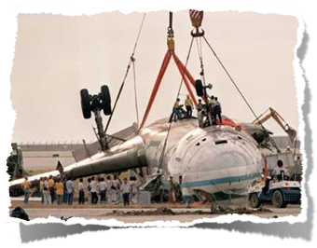
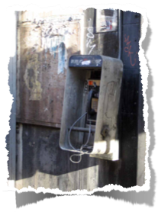


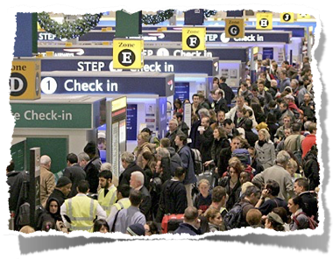
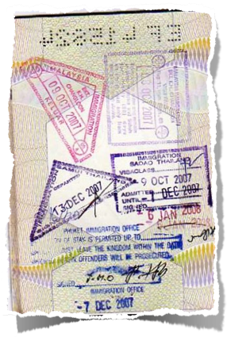

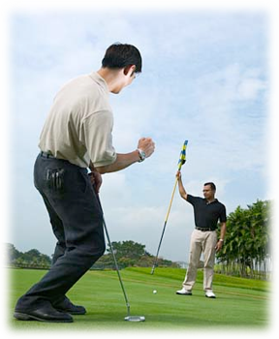
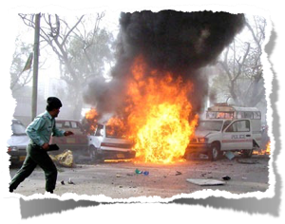
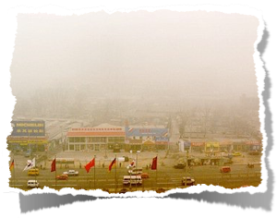

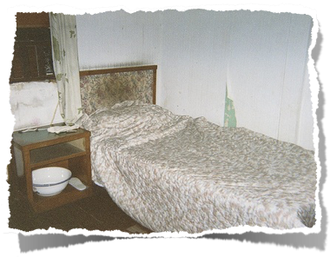
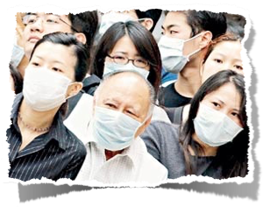
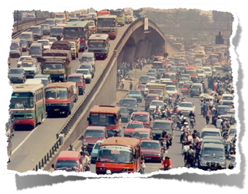


Research Motivation
4

Slide 5
Who Will Be
Interested In This Measure?
Existing and potential managers of foreign subsidiaries;
Anyone contemplating working in or visiting a particular country;
Business Scholars. Provides an easy to use control variable for research on foreign investment, international market entry, expatriate management and cross cultural issues;
Public policy decision makers;

Slide 6
Who Will Be
Interested In This Measure?
Other university departments which focus on international issues; and
Students. Interactive maps and cobweb graphics provide easy to use national summaries. These can be helpful for course projects, case analyses, etc.

Slide 7
Using Hassle Factor
Info in the Class Room
Can be used in every course;
Can bring all students into the conversation;
Changes over time;
Compare within and between countries; and
Multi level considerations: Country, Industry, Firm, Manager (all students are future managers).

Slide 8
Other Uses
of the Hassle Factor Info
Student exchange programs;
Where to recruit students from; and
Useful to alumni.

Slide 9
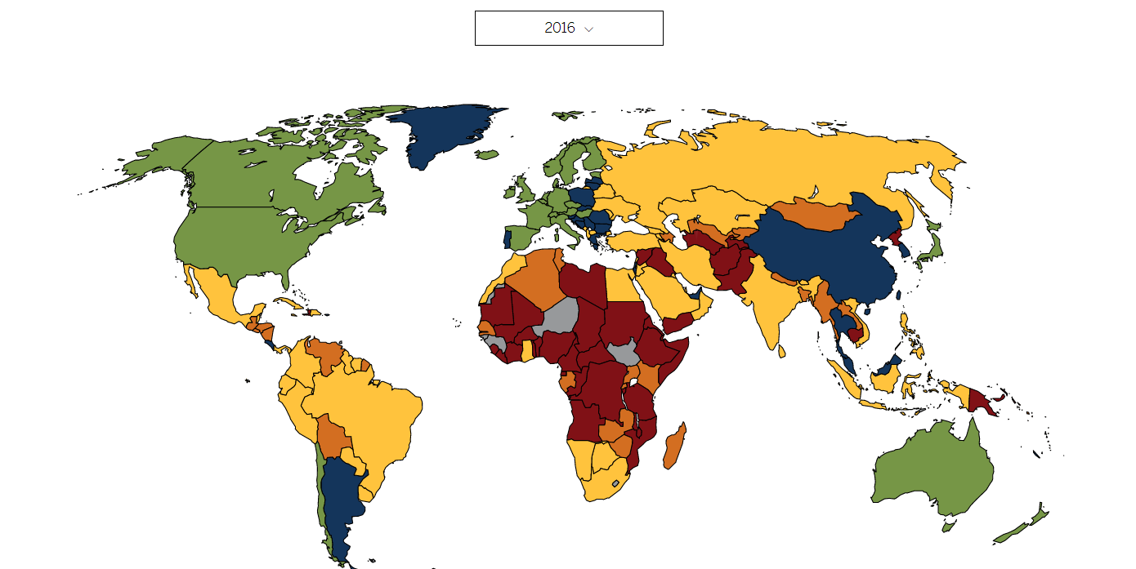
Data Visualization

Slide 10
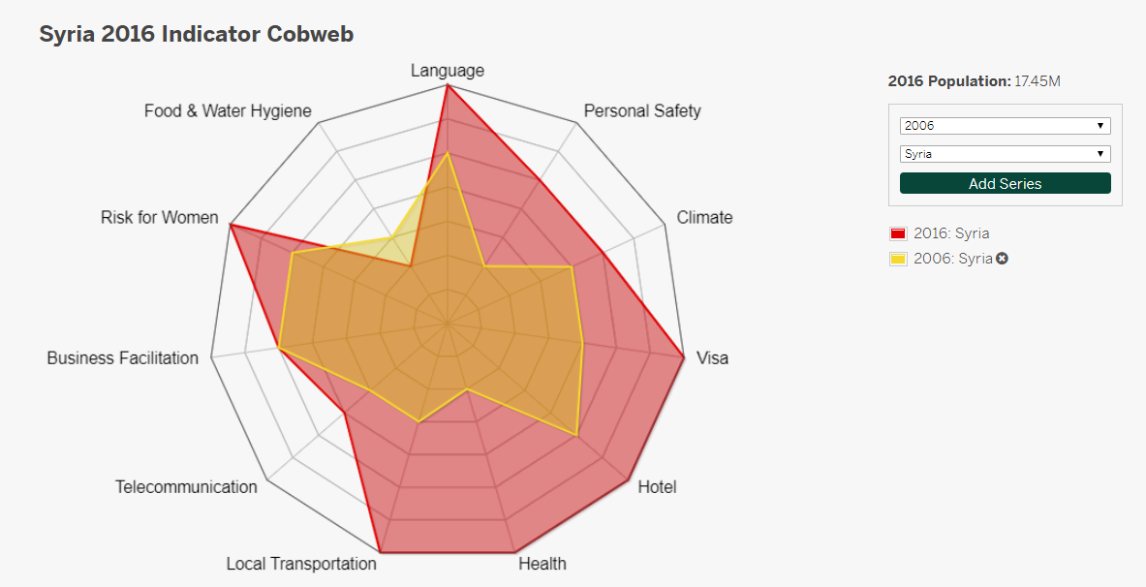
Between Years Comparison
Cobwebs
The Hassle Factor Cobwebs provide a detailed visual representation of the individual hassle indicators per country on a 1 to 7 scale. The indicator values increase from the center (1) to the outer edge (7). The larger the value, the greater the observed hassle.

Slide 11
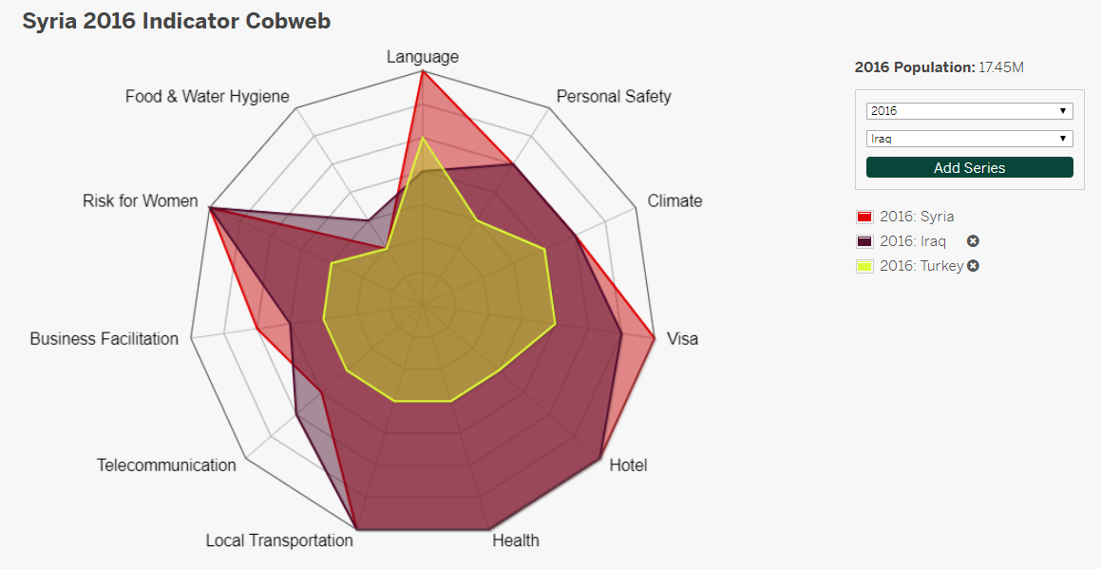
Between Country Comparison

Slide 12
Indicator Data
Both the Hassle Factor scores and indicator scores are available in excel file format.
Users can select the indicators they wish to include in their analyses or research projects.

Slide 13
Best Hassle Factor Rankings
2016 |  |  |  |  | 2012 |  |  |  |  | 2008
Country | Rank | Score |  |  | Country | Rank | Score |  |  | Country | Rank | Score
Sweden | 1 | 1.26 |  |  | UK | 1 | 1.27 |  |  | UK | 1 | 1.18
Denmark | 2 | 1.34 |  |  | Denmark | 2 | 1.27 |  |  | Denmark | 2 | 1.26
UK | 3 | 1.37 |  |  | Sweden | 3 | 1.35 |  |  | Sweden | 3 | 1.26
Germany | 4 | 1.42 |  |  | Belgium | 4 | 1.42 |  |  | Netherlands | 4 | 1.36
Finland | 5 | 1.43 |  |  | Canada | 5 | 1.44 |  |  | Luxembourg | 5 | 1.41
Netherlands | 6 | 1.44 |  |  | Australia | 6 | 1.44 |  |  | Austria | 6 | 1.42
Austria | 7 | 1.49 |  |  | Netherlands | 7 | 1.47 |  |  | Belgium | 7 | 1.42
Belgium | 8 | 1.49 |  |  | Austria | 8 | 1.50 |  |  | Germany | 8 | 1.42
New Zealand | 9 | 1.56 |  |  | Germany | 9 | 1.50 |  |  | Australia | 9 | 1.43
Ireland | 10 | 1.57 |  |  | Finland | 10 | 1.51 |  |  | Finland | 10 | 1.43
Australia | 11 | 1.58 |  |  | Norway | 11 | 1.53 |  |  | Canada | 11 | 1.44
Canada | 12 | 1.60 |  |  | New Zealand | 12 | 1.55 |  |  | USA | 12 | 1.53

Slide 14
Worst Hassle Factor Rankings
2016 |  |  |  |  | 2012 |  |  |  | 2008
Country | Rank | Score |  |  | Country | Rank | Score |  | Country | Rank | Score
Sudan | 168 | 5.31 |  |  | Togo | 168 | 5.35 |  | Sierra Leone | 186 | 5.33
Sierra Leon | 169 | 5.36 |  |  | Angola | 169 | 5.36 |  | Angola | 169 | 5.38
Equatorial Guinea | 170 | 5.44 |  |  | Sierra Leone | 170 | 5.44 |  | Burundi | 170 | 5.45
Libya | 171 | 5.50 |  |  | Burkina Faso | 171 | 5.45 |  | Togo | 171 | 5.45
Iraq | 172 | 5.55 |  |  | D.R. Congo | 172 | 5.54 |  | D.R. Congo | 172 | 5.48
D.R. Congo | 173 | 5.65 |  |  | Burundi | 173 | 5.55 |  | Burkina Faso | 173 | 5.51
Chad | 174 | 5.71 |  |  | Sudan | 174 | 5.64 |  | Eritrea | 174 | 5.67
Syria | 175 | 5.75 |  |  | Eritrea | 175 | 5.67 |  | Chad | 175 | 5.80
Eritrea | 176 | 5.78 |  |  | Chad | 176 | 5.90 |  | Sudan | 176 | 5.90
Yemen | 177 | 5.91 |  |  | Yemen | 177 | 5.91 |  | Yemen | 177 | 5.98
Somalia | 178 | 6.02 |  |  | Cen. African Rep. | 178 | 5.99 |  | Cen. African Rep. | 178 | 6.00
Afghanistan | 179 | 6.21 |  |  | Somalia | 179 | 6.11 |  | Somalia | 179 | 6.02
Cen. African Rep. | 180 | 6.26 |  |  | Afghanistan | 180 | 6.31 |  | Afghanistan | 180 | 6.15

Slide 15
Moving Up
Country | Score 08 | Index 08 | Score 16 | Rank 16 | Index Movement
Azerbaijan | 4.98 | 153 | 4.16 | 116 | +37
Macedonia | 4.04 | 106 | 3.25 | 74 | +32
Ghana | 4.06 | 110 | 3.49 | 83 | +27
Rwanda | 4.82 | 140 | 4.11 | 113 | +27
Romania | 3.47 | 75 | 2.69 | 49 | +26
Bhutan | 4.03 | 105 | 3.47 | 82 | +23
Georgia | 4.02 | 104 | 3.43 | 81 | +23
Latvia | 3.34 | 66 | 2.52 | 44 | +22
Bangladesh | 4.93 | 148 | 4.42 | 128 | +20
Bosnia-Herzegovina | 3.42 | 71 | 2.81 | 54 | +17
Sri Lanka | 4.53 | 129 | 4.04 | 112 | +17
Laos | 5.03 | 155 | 4.64 | 140 | +15
Mexico | 3.84 | 94 | 3.37 | 79 | +15
Timor-Leste | 5.09 | 156 | 4.66 | 141 | +15
Viet Nam | 3.91 | 100 | 3.51 | 85 | +15

Slide 16
Moving Down
Country | Score 08 | Index 08 | Score 16 | Rank 16 | Index Movement
Syria | 4.56 | 130 | 5.75 | 175 | -45
Libya | 4.49 | 127 | 5.50 | 171 | -44
Uganda | 3.84 | 96 | 4.47 | 132 | -36
Venezuela | 3.61 | 79 | 4.14 | 115 | -36
Guatemala | 3.76 | 87 | 4.17 | 118 | -31
Tanzania | 4.32 | 120 | 4.74 | 143 | -23
Haiti | 4.72 | 134 | 5.06 | 156 | -22
Maldives | 2.44 | 40 | 3.00 | 61 | -21
Saudi Arabia | 3.15 | 57 | 3.33 | 78 | -21
Jordan | 3.21 | 61 | 3.41 | 80 | -19
Malawi | 4.74 | 135 | 5.01 | 153 | -18
Zambia | 4.36 | 121 | 4.59 | 138 | -17
Zimbabwe | 4.27 | 118 | 4.55 | 135 | -17

Slide 17
Indicators Driving Movement
Up
Indicator | Average Movement*
Telecom | -1.47
Hotel | -1.33
Food Water Safety | -1.13
Business Facilitation | -0.67
Risk to Female Executives | -0.60
Local Transportation | -0.53
Personal Safety | -0.53
Health | -0.13
Language | -0.13
Visa | 0.00
Climate | +0.33
* Average indicator movement for the top movers in the index rank
Down
Indicator | Average Movement**
Visa | +1.46
Health | +1.08
Risk to Female Executives | +0.85
Language | +0.77
Local Transportation | +0.46
Personal Safety | +0.46
Business Facilitation | +0.23
Hotel | +0.23
Climate | +0.15
Telecom | -0.08
Food Water Safety | -0.23
** Average indicator movement for the bottom movers in the index rank

Slide 18
Methodology
Measures were constructed using a multi method design:
  Indicators were selected based on qualitative literature review;
  Indicators were constructed using both quantitative and qualitative data; and
  Analysis was conducted using quantitative methods.

Slide 19
Indicator Selection
The 11 indicators measured in the Hassle Factor index were selected following a detailed review of academic literature, newspaper articles, and magazines that focused business travel as well as reports from 86 frequent business travelers and travel agents who specialize in business travel.
Face validity was tested with a separate group of experts, including 10 executives and 2 independent relocation consultants.

Slide 20
Indicator Definitions
Indicator | Definition
Business Facilitation | Rating of host nation’s foreign business climate based on reliability and openness.
Climate | Rating of local climate pleasantness and climate risks in each country’s business capital.
Risk to Female Executives | Assessment of risks faced by foreign female travelers.
Food and Water Safety | Classification of health risks related to drinking water and food.
Health | Rating of health hazards, health care availability, and standards of healthcare for foreigners.
Hotel | Assessment of the quality and number of 3-star and better hotels in the main business capital.

Slide 21
Indicator Definitions
Indicator | Definition
Language | Ratio of non-English speakers relative to the total population.
Local Transportation | Rating of availability, safety, and standards of local transportation including bus, taxis, trains, water travel.
Personal Safety | Assessment of physical risks, including war, kidnapping, crime, social unrest, and natural disasters.
Telecommunications | Availability and accessibility of telephone services, cell phone coverage, and internet.
Visa | Requirements and difficulties in obtaining a business visitor visa, including processing time, references needed, access to consulate, cost, and duration of visa granted.

Slide 22
Sub-Indicators & Measurements
Indicator | Sub-Indicators | Measurement
Business Facilitation | (n=6) Meeting reliability, reliably implement agreements, speed of decision making, access to the decision maker, openness to foreign businesspersons, negotiating attitude | Sub-indicators coded on a 3 point Likert scale and converted to 1-7 scales.
Climate | (n=4) Temperature, precipitation, humidity and major weather events | Sub-indicators measures were recorded on a multi item scale based on proximity to a baseline. The indicator score was calculated using the sum of the sub-indicators.
Risk to Female Executives | (n=2) Physical security of women (PSW) and travel risk (TR) PSW data comes in a 1-4 scale, TR data in a 1-5 scale | Data was converted to a 1-7 scale.

Slide 23
Sub-Indicators & Measurements
Indicator | Sub-Indicators | Measurement
Food and Water Safety | (n=2) Water safety and food safety | Data was converted to a 1-7 scale.
Health | (n=4) Quality, accessibility, consistency and health hazards | Sub-indicators measures were recorded on a multi item scale and converted to a 1-7 scale.
Visa | (n=4) Number of countries exempt from visa requirements, number of documents required to obtain a short-term visa, travel health insurance requirement, moderator* | Sub-indicators were coded on a multi item scale and converted to a 1-7 scale.
* Moderator: assessment of the complexity in obtaining a visa when required. It considers: cost, processing time, number of foreign missions and the types of visa available: single/ multi-entry, etc. We used the moderator that combined these four items because data was incomplete and/or changed frequently for each of these items.

Slide 24
Sub-Indicators & Measurements
Indicator | Sub-Indicators | Measurement
Hotel | (n=1) Average number of hotels available from both sources within 5 km of the city center | Converted to a 1-7 scale.
Language | (n=2) Number of English speakers, and total population | Converted to a 1-7 scale.
Local Transportation | (n=6) Availability of safe and affordable: cars, taxis, trains subways, busses and water travel | Sub-indicators were coded on a 4 point Likert scale and converted to a 1-7 scale using.

Slide 25
Sub-Indicators & Measurements
Indicator | Sub-Indicators | Measurement
Personal Safety | - | Data comes from Control Risk in a 1-5 scale. We used ratings for business capital cities.
Telecommunications | (n=4) Access, usage, quality and affordability | Sub-indicators measures were recorded on 3 point scales based on proximity to a baseline. The indicator score was calculated using the (sum of the sub-indicators + 1)*0.75 (rounded to the nearest whole number).

Slide 26
Methodology Notes
A detailed overview of the Hassle Factor methodology is available at www.ivey.uwo.ca/internationalbusiness/research/hasslefactor/methodology/

Slide 27
Data Sources
Indicator | Data Type | Data Source
Business Facilitation | Qualitative | Global Road Warrior. Business Culture. http://www.globalroadwarrior.com
Climate | Quantitative | Weather Base. Monthly All Data. https://www.weatherbase.com/ Weather Spark. Historical Weather. https://weatherspark.com/
Risk to Female Executives | Quantitative | Control Risk. Risk Map. https://www.controlrisks.com/riskmap/analysts-picks-map?source=RMLP Womanstats Project. Scale #1: Physical Security of Women. http://www.womanstats.org/
Food and Water Safety | Quantitative | World Health Organization. Global Health Observatory Data Repository Food Safety http://apps.who.int/gho/data/view.main.IHRREG11v World Health Organization/UNICEF. Joint Monitoring Program for Water Supply Water. https://washdata.org/data/household#!/
Health | Qualitative | Center for Disease Control. Destinations. https://wwwnc.cdc.gov/travel/destinations/list Global Road Warrior. Health and Medical. http://www.globalroadwarrior.com Pacific Prime. https://www.pacificprime.com/

Slide 28
Data Sources
Indicator | Data Type | Data Source
Hotel | Quantitative | Hotels.com https://ca.hotels.com Hotels. https://expedia.com
Language | Quantitative | Telegraph Travel: https://telegraphtravel.carto.com/me/*
Local Transportation | Qualitative | Global Road Warrior. Health and Medical. http://www.globalroadwarrior.com
Personal Safety | Quantitative | Control Risk. Risk Map. https://www.controlrisks.com/riskmap/analysts-picks-map?source=RMLP
Telecommunications | Qualitative | World Bank. Little Data Books on Information and Communication Technology. https://data.worldbank.org/products/data-books/little-data-book-on-info-communication-tech
Visa | Quantitative | Global Road Warrior. Travel Essentials, Visa and Passport.. http://www.globalroadwarrior.com Welcoming Countries Rank. 2019. Passport Index https://www.passportindex.org/byWelcomingRank.php
* A full list of language sources will be published in the methodology note

Slide 29
Factor Loads
Indicator | 2006 | 2008 | 2010 | 2012 | 2014 | 2016
Health | 0.867 | 0.898 | 0.891 | 0.894 | 0.887 | 0.902
Local Transportation | 0.899 | 0.867 | 0.871 | 0.875 | 0.881 | 0.885
Hotel | 0.784 | 0.814 | 0.823 | 0.834 | 0.835 | 0.841
Business Facilitation | 0.864 | 0.807 | 0.829 | 0.827 | 0.840 | 0.833
Telecom | 0.788* | 0.834 | 0.826 | 0.817 | 0.810 | 0.812
Female Risk | 0.798* | 0.787 | 0.810 | 0.808 | 0.796 | 0.791
Food Water Safety | 0.854 | 0.771 | 0.792 | 0.795 | 0.736 | 0.751
Personal Safety | 0.744 | 0.712 | 0.73 | 0.744 | 0.753 | 0.724
Visa | 0.761 | 0.682 | 0.697 | 0.745 | 0.718 | 0.711
Climate | 0.799* | 0.650 | 0.632 | 0.659 | 0.668 | 0.615
Language | 0.563 | 0.609 | 0.614 | 0.593 | 0.593 | 0.566
* Measure changed in subsequent years

Slide 30
Status of the Project –
Face Validity Testing
Launching a beta test of the data to assess concept validity;
Involves circulating the beta website to a select academic community to solicit feedback; and
Multi phase testing
  First phase will be limited to scholars close to Ivey
  Second phase will expand to a wider IB academic community

Slide 31
Status of the Project –
Discriminant Validity Testing
Concurrent to the beta testing, we will be replicating the quantitative tests for discriminant validity using the 2008-2016 data.
These tests will compare our measure to existing indices measuring the business environment in various countries.

Slide 32
Status of the Project –
Discriminant Validity Testing
The tests will help us determine the extent to which our measure is unique.
Examples of other indices or measures include:
  Rankings & Ease of Doing Business Score from the World Bank;
  Global Competitiveness Report from the World Economic Forum;
  FDI Attractiveness Survey from Ernst and Young;
  Population from the World Bank;
  Corruption Perception Index from Amnesty International;
  Cultural Distance from Kogut and Singh (1988);
  Political Constraints Index from Henisz (2000); and
  Index of Economic Freedom from the Heritage Foundation.

Slide 33
Limitations
Business capitals*: due to the number of countries and variables included in the measures it was impractical to collect data from multiple locales within each country. As a result, we sometimes limited our data collection to each country's business capital**.
The use of specific locales as representative of a larger geographic area is similar to the method commonly used for calculating consumer price indexes.
*See our website for a list of business capitals
**Review our indicator methodology notes for measures that use data from a single locale

Slide 34
Limitations
Data sources: In an effort to ensure our measure is truly global, we monitor 180 economies.
While many quality data sources are available for between 100 and 130 economies we chose sources with data on at least 165 economies.
In practice this means we often rely on raw data from primary sources such as the World Bank, World Health Organization and the United Nations.
Examples of widely available indexes or data that we exclude due to limited country coverage include:
  Global Food Security Index from the Economist;
  Global Hotel Study from STR; and
  Global Connectivity Index from Huawei.

