Slide 1

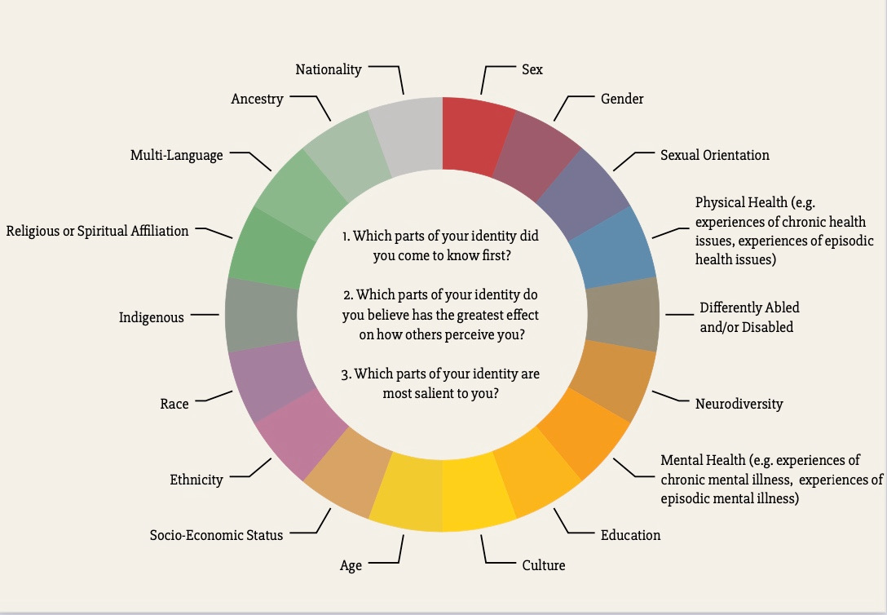
Positionality Wheel
Take a few moments to complete the following social identity wheel. Think about the places on this wheel you find your own identity.
This social identity wheel will support you in identifying and uncovering the intersecting and complex components that construct your social identity. Some aspects may be well understood as you work your way through this exercise; other social identities may be emerging; and some you may have not considered.
This is self-paced work, and the goal is to reflect as you make your way through this exercise about the multidimensional and intersectional ways your social identity is constructed, and the parts of this social identity you feel comfortable sharing.

Slide 2
Invitation to reflect:
Which parts of your identity did you come to know first?

Slide 3
Invitation to reflect:
Which parts of your identity do you believe have the greatest effect on how others perceive you?

Slide 4
Invitation to reflect:
Which parts of your identity are most salient to you?

