Slide 1
THE INTELLIGENT INVESTOR: WHAT CAN WE LEARN FROM GRAHAM THAT STILL MATTERS?
Jason Zweig
The Wall Street Journal

Slide 2
May 1894: Benjamin Graham born
May 1949: The Intelligent Investor published
How can a 75-year-old book, written by someone born 130 years ago, still be relevant?
The Challenge

Slide 3
Graham’s Genius
intellectual
student, scholar, teacher, inventor, author
investor
1936-1956:
S&P 500: 12.13%
Graham-Newman Corp.: 17.39%
outperformance “far more terrific” than that (Apr. 14, 2023)
does not count GEICO spinout for G-N investors!
psychologist
Mr. Market
“The chief advantage, perhaps, is that such a formula will give him something to do.”
“You are neither right nor wrong because the crowd disagrees with you. You are right because your data and your reasoning are right.”

Slide 4
Formulaic Graham
The Intelligent Investor (2003 edition), p. 295.

Slide 5
P/E * P/B ≤ 22.5
“Net-nets”
P = ⅔ * NCAV
“Earnings yield at least twice the high-grade bond yield”
E/P ≥ 2 * [AAA-rated industrial-bond yield]
Formulaic Graham

Slide 6
Why Graham Still Matters
Graham’s message is not about formulas!
It is about first principles!
a stock is not a ticker symbol or a stream of price changes
Mr. Market
MOS
Above all: If you want to succeed, organize for success

Slide 7
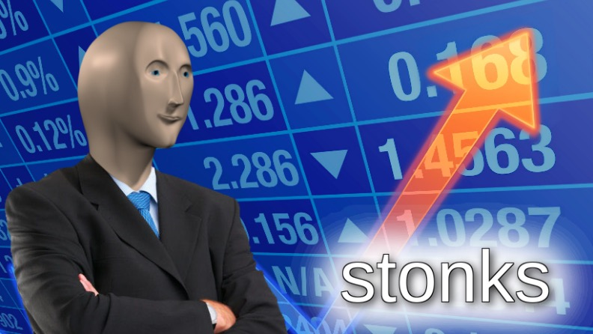
Who Is Mr. Market?

Slide 8
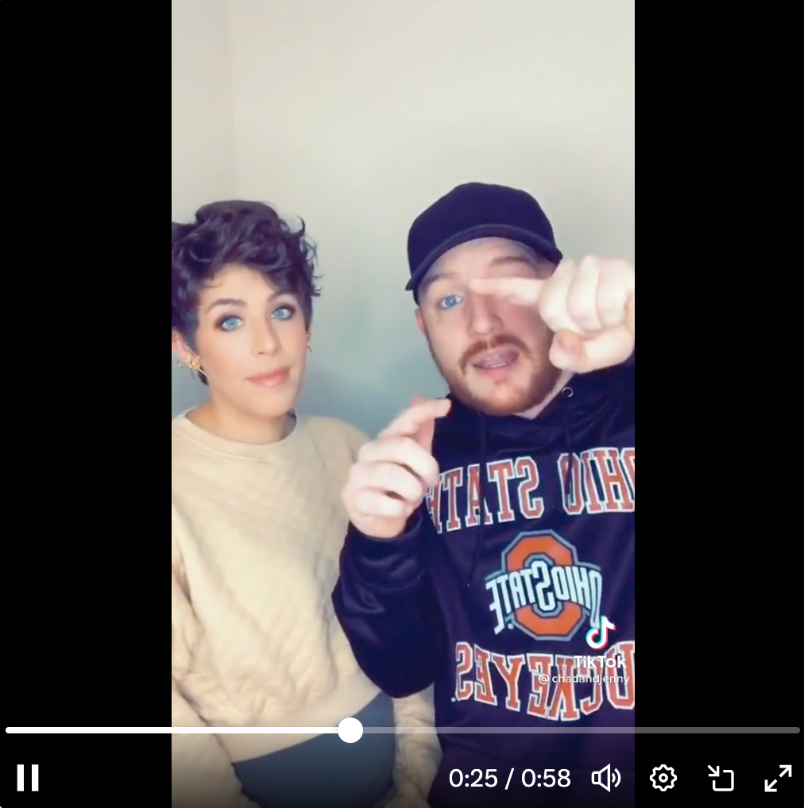
Who Is Mr. Market?
“I see a stock going up, and I buy it. And I just watch it until it stops going up, and then I sell it. And I do that over and over, and it pays for our whole lifestyle.”

Slide 9
Meet Mr. Market
Most of the time, “his idea of value appears plausible and justified by business developments and prospects as you know them.”
Mr. Market is moody, but he is not a moron
Most of the time, Mr. Market is an ETF:
patient (TO ~5%) → transaction costs almost nil
low cost (≤ 5bp)
tax efficient

Slide 10
Meet Mr. Market
Mr. Market is an ETF, and you are not.
Assume your expense ratio is only 75bp, your portfolio turnover rate is only 50%, and your total one-way transaction costs are only 50bp.
Assume the expected return on equities is 10% and your objective is to outperform the market by 10%, i.e. = 11%.
How much do you have to outperform before costs to meet your objective after costs?
For a net return of 100 bp > a 10% market, you have to generate 225 bp of gross outperformance
The lower the market rate of return, the larger your frictional costs loom!
Source: Charles D. Ellis, “The Loser’s Game” (FAJ, July-August 1975)

Slide 11
“Unless structure follows strategy, inefficiency results” (Alfred Chandler).
“At most asset managers, strategy follows structure instead. As a result, funds own too many stocks, trade too frequently and charge too much. No wonder most active managers underperform market-tracking index funds that charge a fraction of their fees.” (https://on.wsj.com/3IZYEBl)
Benchmark the performance, not the portfolio
Graham-Newman Corp.
open-end mutual fund permanently closed to new investors
small AUM (~$6.5M max [1955] or ≈ $200M today)
10-for-1 reverse split to keep average NAV above $1,000 per share!
loyal, supportive, informed community of investors
no procyclical cash flows pressuring the managers
mandate responsive to market conditions
the ability, not the pretense, to be active!
Flexible Graham

Slide 12
Where Do You Think Buffett Learned to Be Flexible?
Ben Graham 1.0 and 2.0:
Benjamin Graham Joint Account (1926-36) and Graham-Newman Fund (1936-56):
fundamental analysis on single stocks
special situations
merger arbitrage
cash: defense and offense
Ben Graham 3.0:
Graham’s PA and the Graham-Rea Fund (1970s):
looking for statistical commonalities to identify “group undervaluation”
analyzed 50(!) years of data
net-nets, high earnings yields, high dividend yields
In every edition of the book, he re-tested all his major formulas -- and threw many out
He bent his own valuation rules to buy GEICO
He admitted that GEICO may have been a “lucky break” rather than “shrewd”

Slide 13
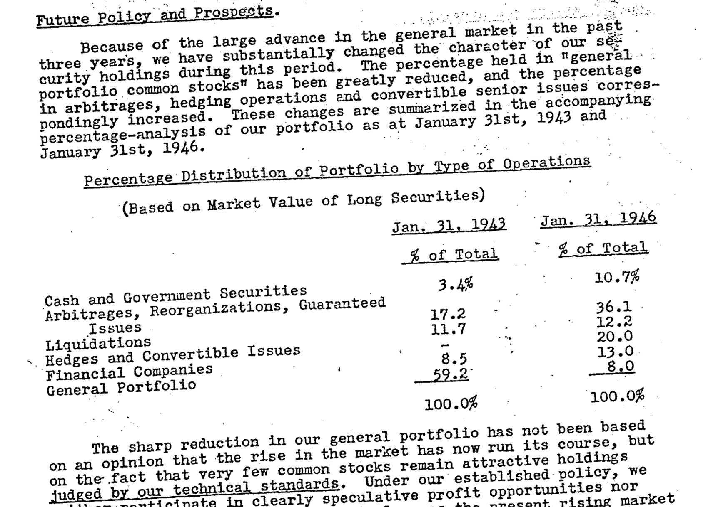
Graham: On Portfolio Policy
Graham-Newman Corp. annual report, Feb. 28, 1946

Slide 14
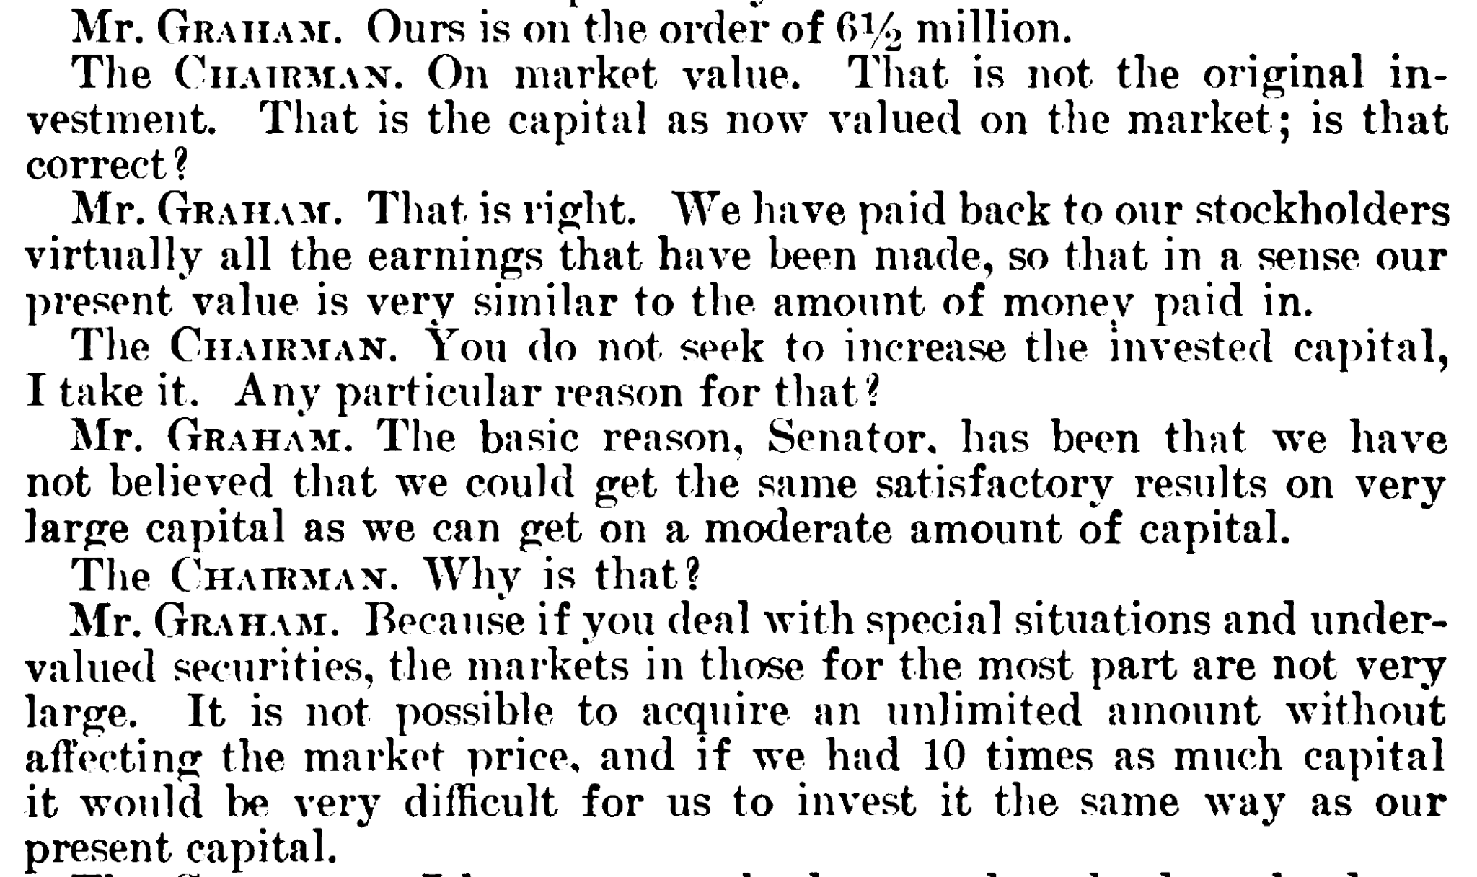
Graham: On Capacity
Testimony, U.S. Senate Committee on Banking and Currency, March 11, 1955, bit.ly/4cAdtIp

Slide 15
Graham: On Alignment
Testimony, U.S. Senate Committee on Banking and Currency, March 11, 1955, bit.ly/4cAdtIp

Slide 16
What Would Ben Do?
Would Ben Graham be running a LCV mutual fund / SMA if he were around today?
Cash flows from (and to!) clients: not just a blessing but a curse
Graham-Newman: closed to new investors for much of its history
Whatever can be an ETF will be an ETF
What can’t be ETF’d?
Left tails: size, liquidity, marketability, popularity
Microcaps
Merger arbitrage
Community banks
Bankruptcies and spinoffs
Orphan stocks deleted from index funds

Slide 17
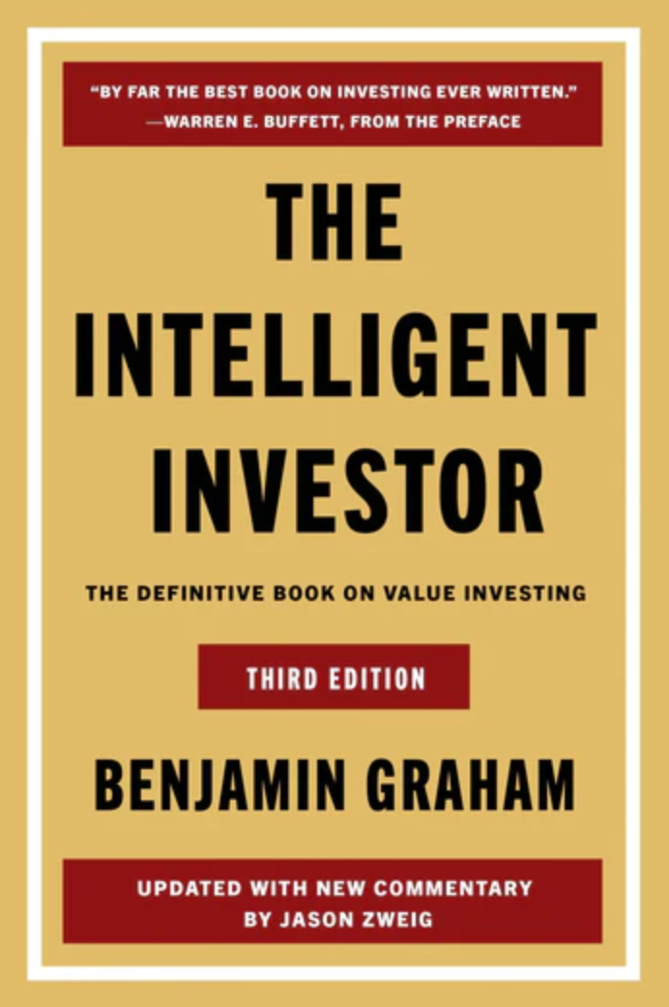
Oct. 22, 2024
https://amzn.to/43VEeDi

Slide 18
For Further Reading:
”Lessons and Ideas from Benjamin Graham”
“A Rediscovered Masterpiece by Benjamin Graham”
Benjamin Graham: Building a Profession
intelligentinvestor@wsj.com
Thank You!

Slide 19
2024 VALUE INVESTING CONFERENCE
The Ben Graham Centre’s
@BGCVI #BGCVIevents

