Slide 1


The Future of Fundamental Analysis: Can Humans and Machines Co-Exist?
Name: Andi Kerenxhi, CFA
E-mail: akerenxhi@ubineer.com
Website: www.Ubineer.com
Social: www.linkedin.com/company/ubineer/
CONFIDENTIAL
APR 2024

Slide 2

Two Epochs
Fundamentalists (Knowledge)
Capture large alpha from earning surprises & time on market
1920s |  |  |  |  |  |  |  | 2000s
Quants (Compute)
Analyze historical prices & factors to find mispricings.
Systematic & backtested small alpha + leverage = large alpha
CONFIDENTIAL
APR 2024

Slide 3
New Technology
Generative Pre-trained Transformer (GPT)
Large Language Models
(LLM)
Who are the winners?
CONFIDENTIAL
APR 2024
Notes:
Who will be the winner and who will be the looser

Slide 4
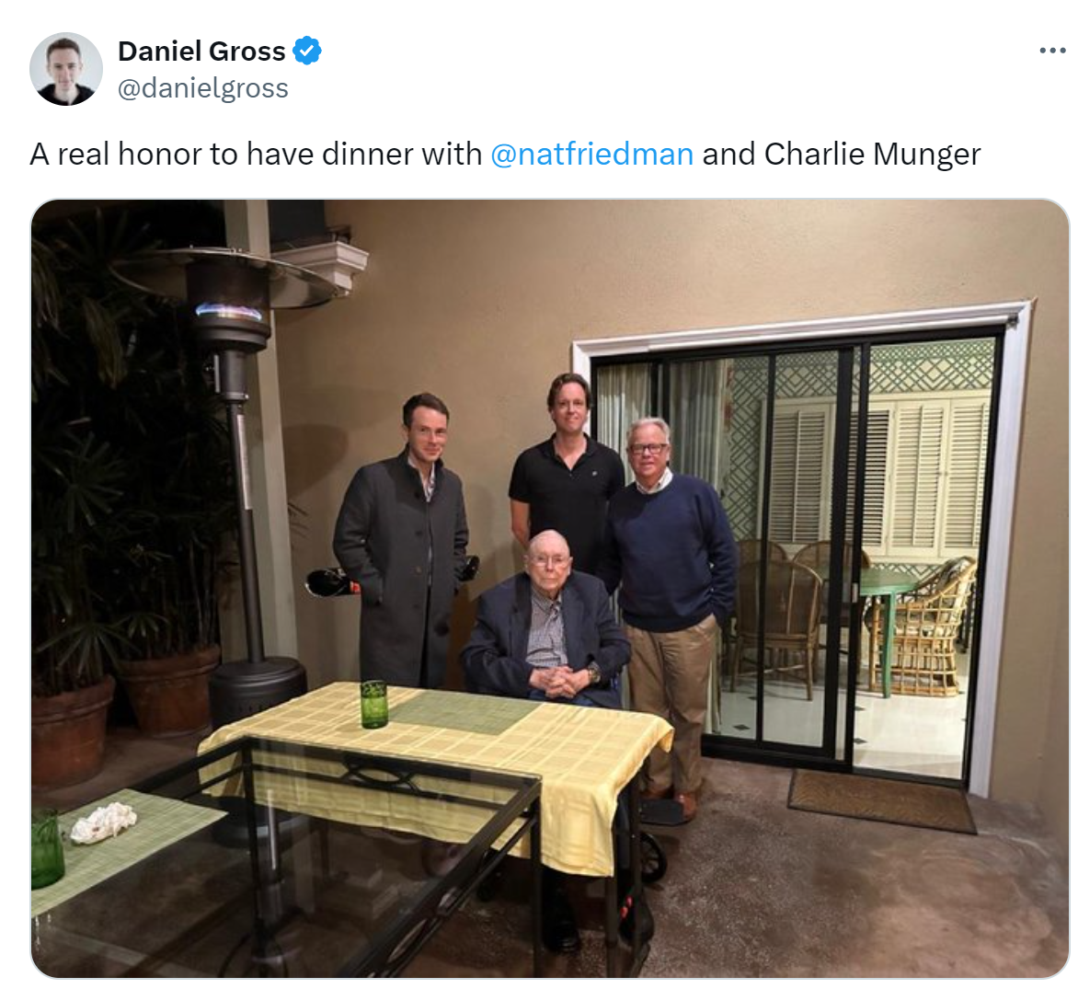
Open Mind & Humble
CONFIDENTIAL
APR 2024

Slide 5
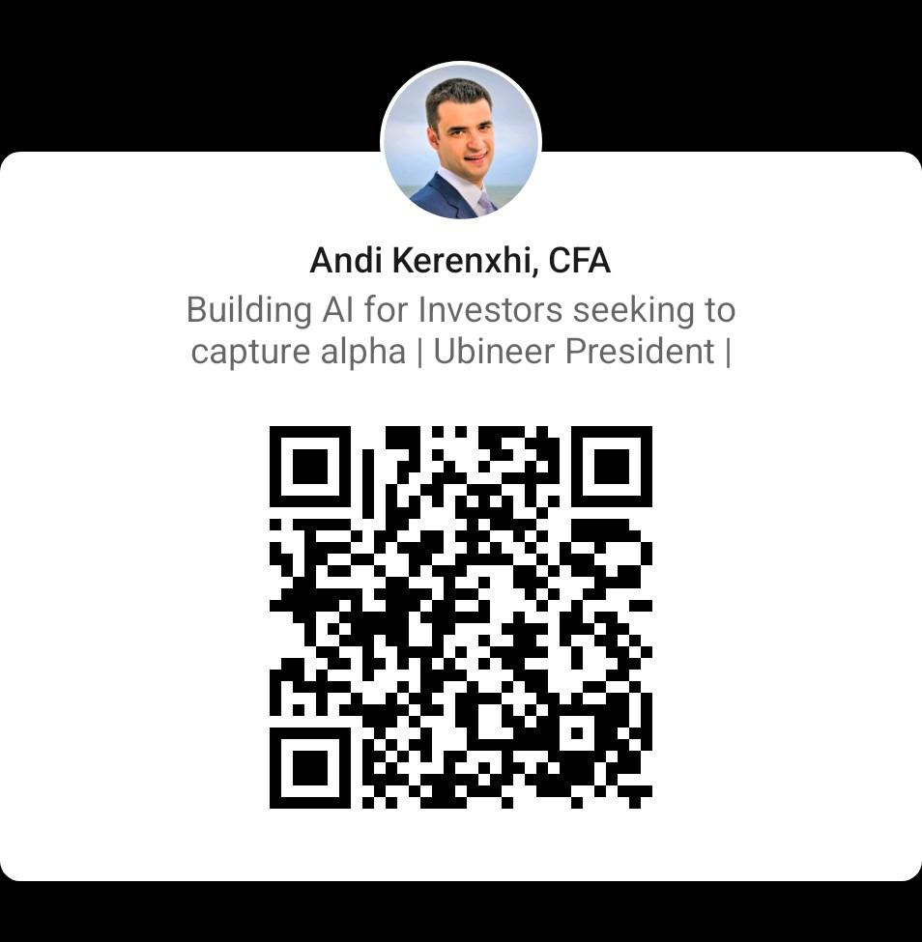




Why me?
8+ years experience as software equity analyst
HBSc from University of Toronto-Quantitative Analysis Mathematical Finance, Management and Economics
=
CONFIDENTIAL
APR 2024

Slide 6
What Assumptions are priced in?
Humans will encounter many LLMs or multimodal models per day
The models will do semi-complex tasks
Agency/Morality will still reside with Humans
We are really early and not close to a local maxima
CONFIDENTIAL
APR 2024

Slide 7
Priced in Assumptions # 2
More products are required:
  Chat is not the only interface
Connectivity is in place so if a product works it will capture market share quicker than previous generations
We will still chew gum the same way
CONFIDENTIAL
APR 2024

Slide 8
Questions Asked of LLMs Q4 2022
Human Creativity can’t be replaced
Limited Context
It is not Current
It can’t Compute
CONFIDENTIAL
APR 2024

Slide 9




All Solved in 6 Quarters
Human Creativity can’t be replaced
Limited Context
It is not Current
It can’t Compute
CONFIDENTIAL
APR 2024

Slide 10
Our main learnings
Large Language Models (LLM)
Require
Correct Compute &
Information
CONFIDENTIAL
APR 2024

Slide 11

A tough question to ask?
What should
content strategy be?
CONFIDENTIAL
APR 2024
Notes:
1 Sentence:
We create software that empowers institutional investors to improve and make their investment analysis process more effective and efficient. So they can capture alpha in the market.

Slide 12
What an LLM needs?
Instructions
LLM
Generated
Output
Text
Tables & Graphs
Custom Formulas
Sector Insights
CONFIDENTIAL
APR 2024

Slide 13
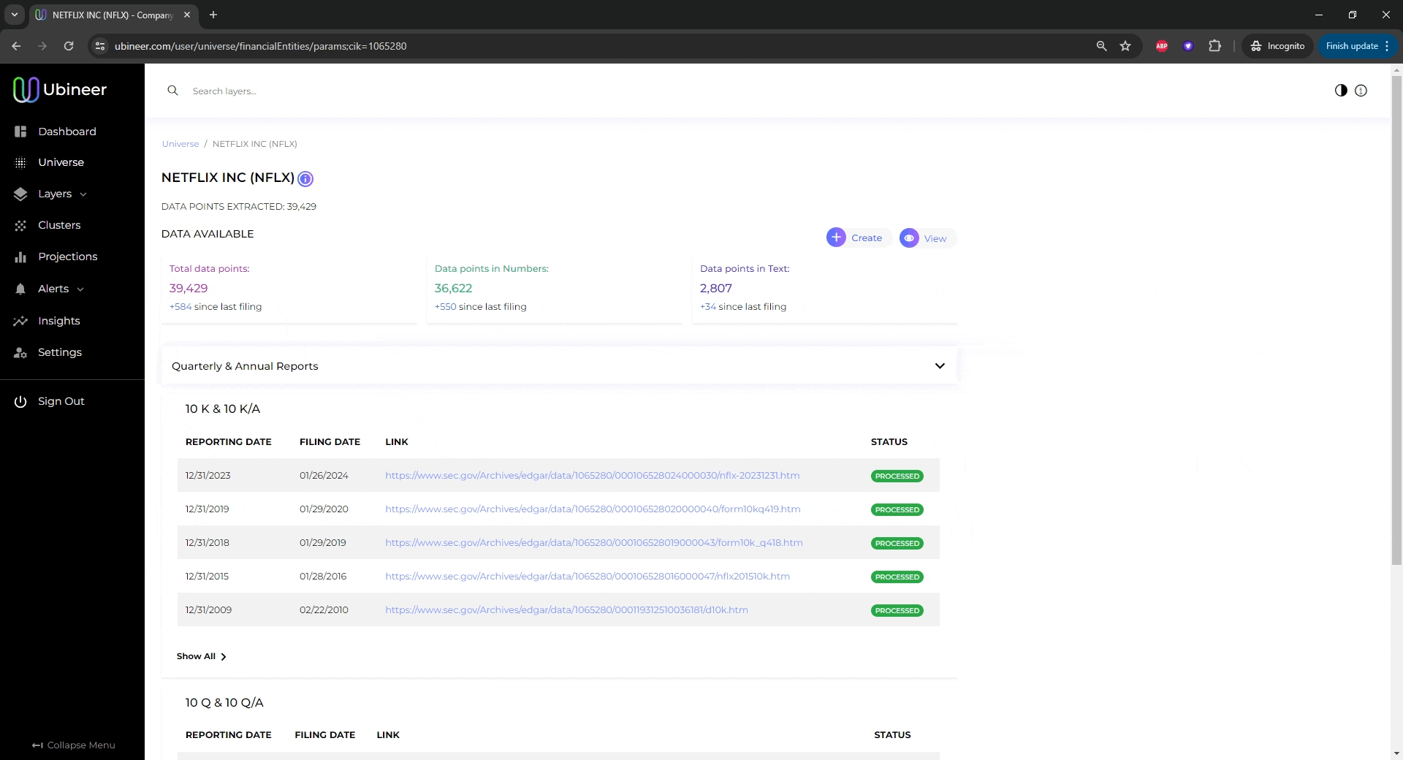

Text Example
Automated
Data Capture
CONFIDENTIAL
APR 2024

Slide 14
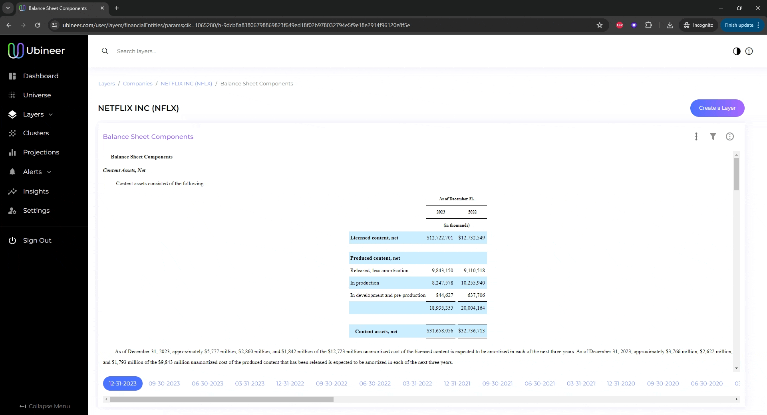
Tables and Graphs
Automated
Data Input
CONFIDENTIAL
APR 2024

Slide 15
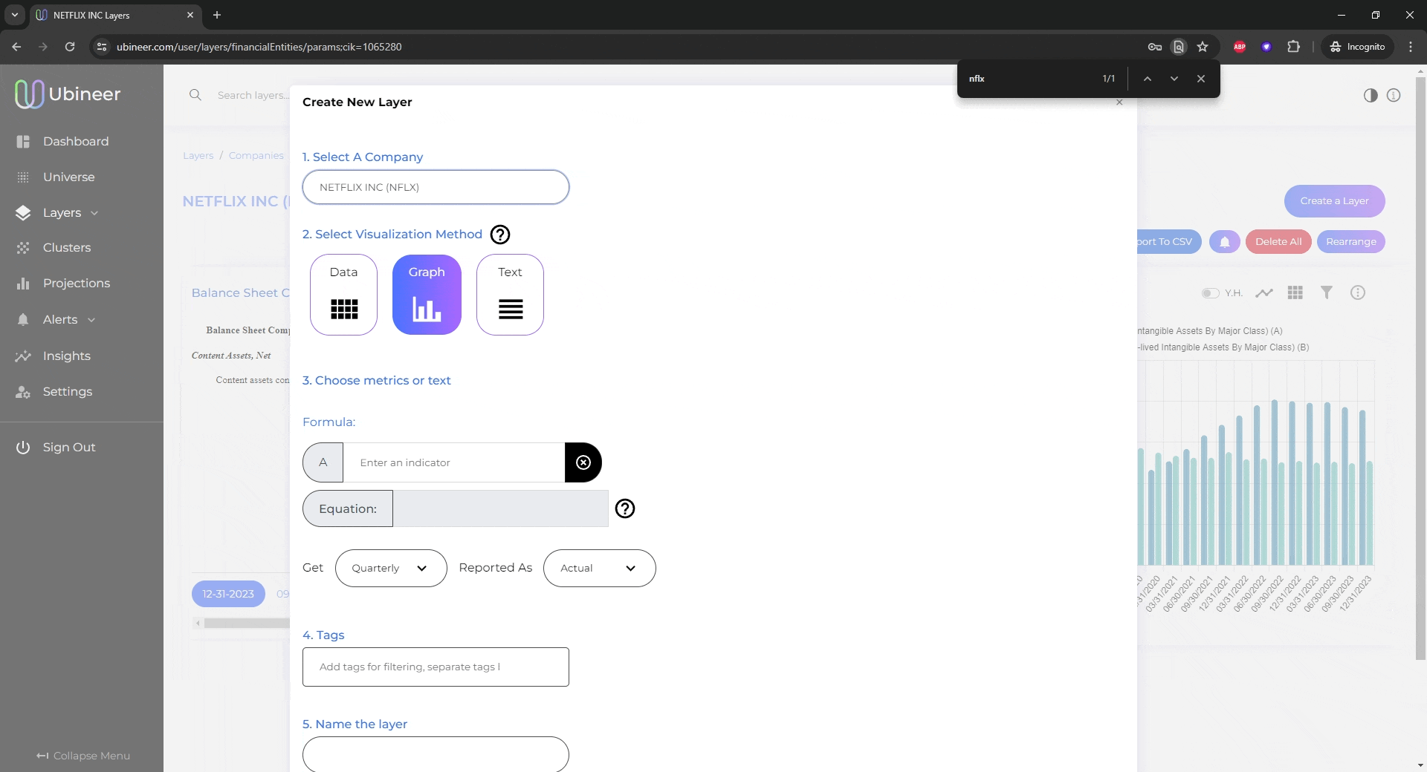
Formulas…
Automated
Data Input
CONFIDENTIAL
APR 2024

Slide 16
Get smaller LLM to Create Layers
Instructions
LLM
Generated
Output
Text
Tables & Graphs
Custom Formulas
Sector Insights
LLM
CONFIDENTIAL
APR 2024
Instructions
Notes:
Before starting this venture I was an Analyst and PM for an investment fund in Canada where I spent approximately 70% of my time doing crucial work that didn’t generate much value.

Slide 17
Layers generated by LLM?
Instructions
LLM
14 Layers over four companies
CONFIDENTIAL
APR 2024
Notes:
1 Sentence:
We create software that empowers institutional investors to improve and make their investment analysis process more effective and efficient. So they can capture alpha in the market.

Slide 18
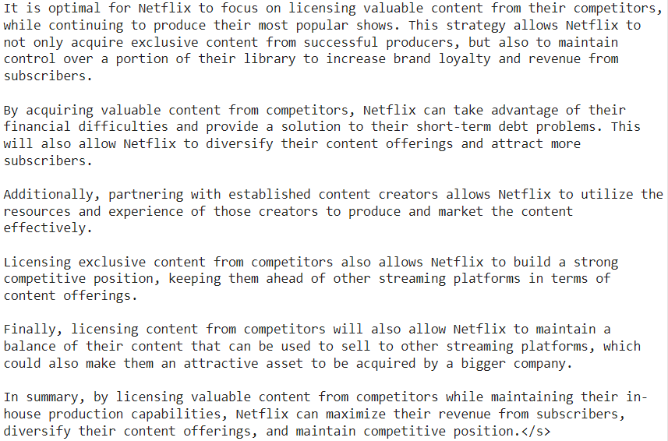
LLM Generated output
CONFIDENTIAL
APR 2024
Notes:
1 Sentence:
We create software that empowers institutional investors to improve and make their investment analysis process more effective and efficient. So they can capture alpha in the market.

Slide 19
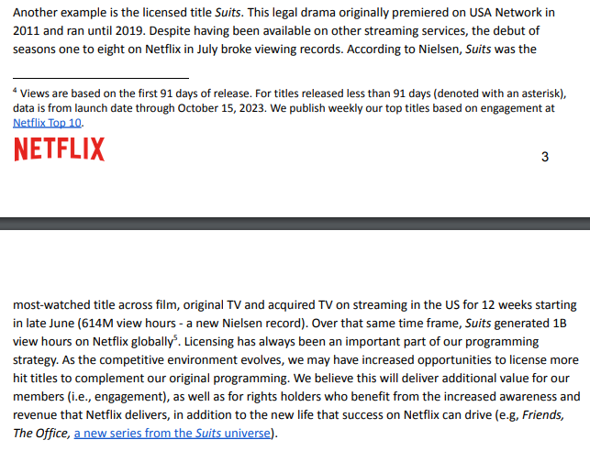
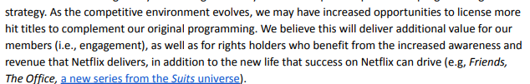
Verified by management
CONFIDENTIAL
APR 2024
Notes:
1 Sentence:
We create software that empowers institutional investors to improve and make their investment analysis process more effective and efficient. So they can capture alpha in the market.

Slide 20
Is this a new data set or an edge?
In-depth
Analysis
Smarter Insights
Breadth/Scale
CONFIDENTIAL
APR 2024

Slide 21
Our Mental Model with LLMs
If a task is iterative and simple, LLMs will win.
  Capture/organize data from the web
  Parts of coding
LLMs will make us more knowledgeable
  Above example
  Specific Agents
CONFIDENTIAL
APR 2024

Slide 22
A low probability future?
Fundamentalist understand the underlying businesses better than the Quants.
But … Don’t adapt quickly to technology.
CONFIDENTIAL
APR 2024
Notes:
Before starting this venture I was an Analyst and PM for an investment fund in Canada where I spent approximately 70% of my time doing crucial work that didn’t generate much value.

Slide 23
Machine augmented decisions
Fundamentalist thinks of a question
Research done by LLM “analyst”
Value Accretive or Destructive is decided by the Fundamentalist
CONFIDENTIAL
APR 2024

Slide 24
Conclusion
Fundamentalists: will feel like they are working with many really smart friends
Quant world and Fundamental world should converge
Winner: whoever generates the most valuable tokens
CONFIDENTIAL
APR 2024

Slide 25
Thanks!
akerenxhi@ubineer.com | www.ubineer.com | @ubineer
CONFIDENTIAL
APR 2024
Notes:
On behalf of our team I want to thank you all for your time and we looking forward to working with you.

